Slide 1

God Only Knows

Slide 2
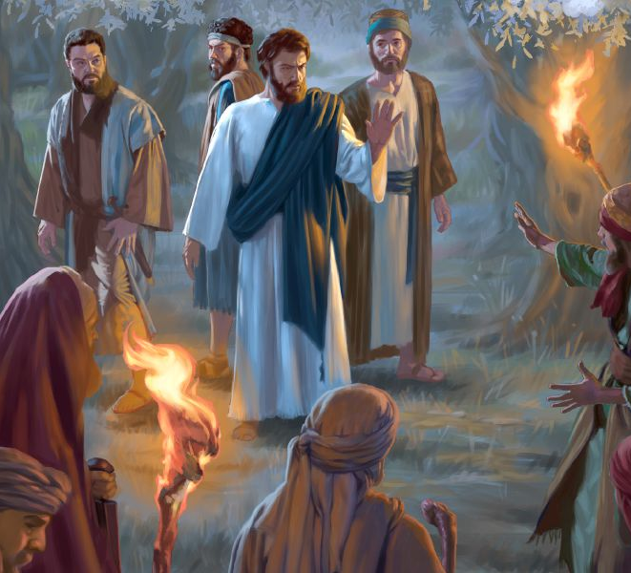
Taking Control of the Situation
John 18:1-11
Captain of our Salvation

Slide 3
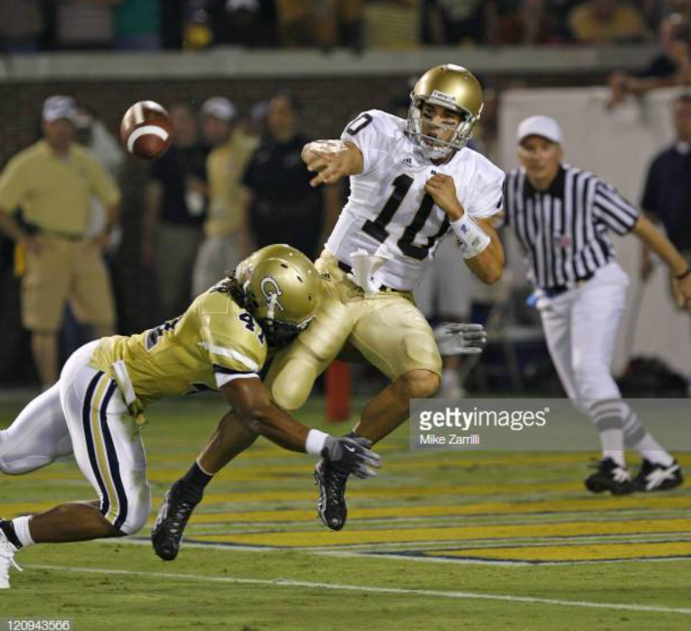
Standing in and Taking the Hit
QB Earns the respect of his teammates
Willing to follow his leadership
Character of the team revolves around the character of the QB
He’s their Captain!

Slide 4
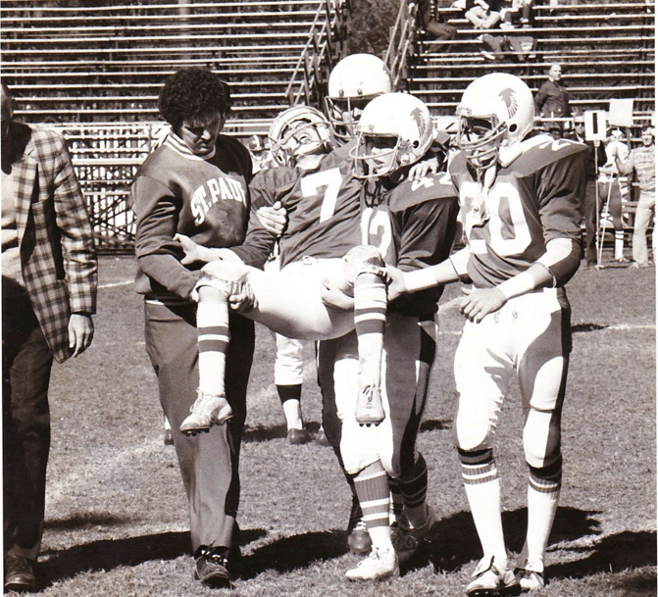
Christians Take the Spiritual Hit for Others

Slide 5
Meeting with His Enemies
Arrest was Orchestrated by Him – “His time had come”
Stepped in the gap for us!
Demonstrated willingness to go to the cross
The Servant knew what this service would accomplish for others
Captain of our Salvation (Hebrews 2:9-10)

Slide 6
God Only Knows

Slide 7
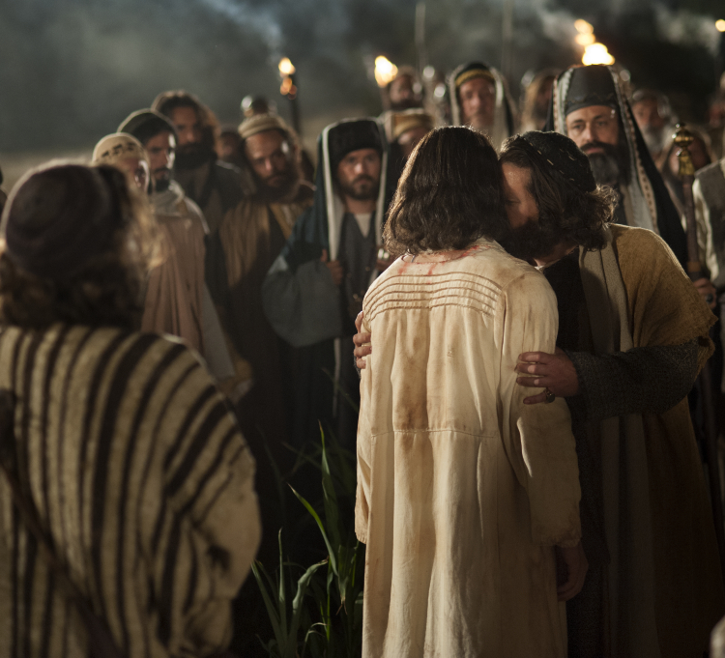
Judas’ Kiss
How does it feel when the prodigal won’t come home?
How does it feel when a lamb has gone astray?
How does it feel when they give up in the race?
How does it feel when they willingly disobey?
How does it feel when they willingly walk away?

Slide 8
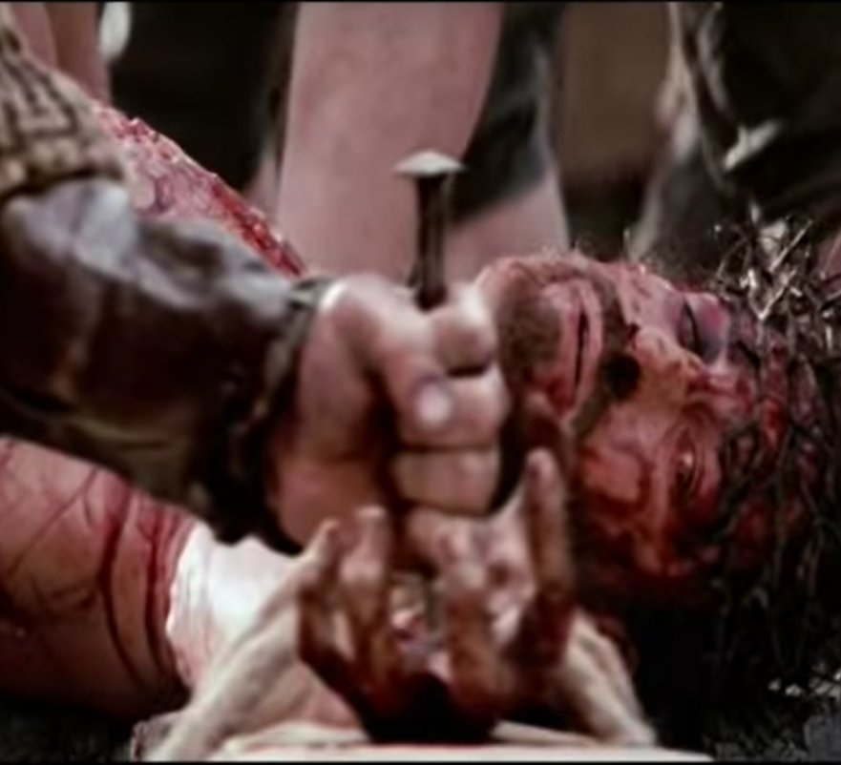
It Must Be…
like another thorn stuck in your brow
like another close friend’s broken vow
Feel like another nail right through your wrist!
Just like Judas Kiss
          Petra

Slide 9
God Only Knows

Slide 10
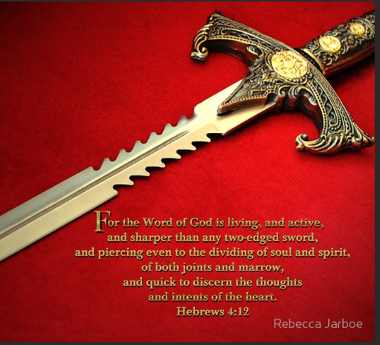
Two-Edged Sword
Hebrews 4:12-13
How am I to respond? How would you respond?
Some made to do damage on the way out
Cutting things out of our life that entangle us with the affairs of this world

Slide 11
God Only Knows

Slide 12
He Called Him Friend
Matthew 26:47-56
Most touching act in scripture
Tenderness and Compassion of our Lord Jesus Christ

Slide 13
God Only Knows

Slide 14
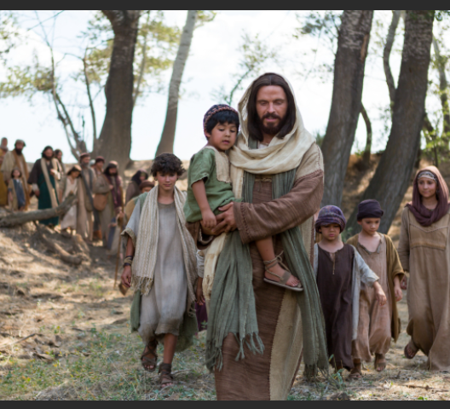
Be Ye Followers of Me…Jesus
Be considerate of those following you follow the Lord!
I Corinthians 4:15-16; 11:1
Be ye followers of me, even as I am following Christ!
Philippians 3:17 – Be an example in the Home, Church, Community

Slide 15
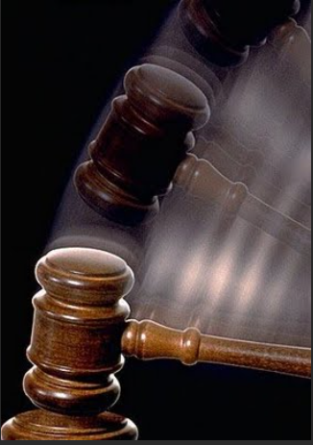
3 Court Judgments
Court of Public Opinion
Court of One’s Own Conscience
Court of the Supreme Judge

Slide 16
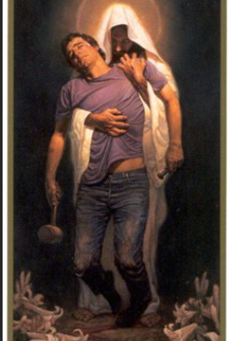
Forgiven
Are we willing to forgive our brothers & sisters?
Are we willing to be forgiven ourselves?
Are we willing to be changed?

Slide 17
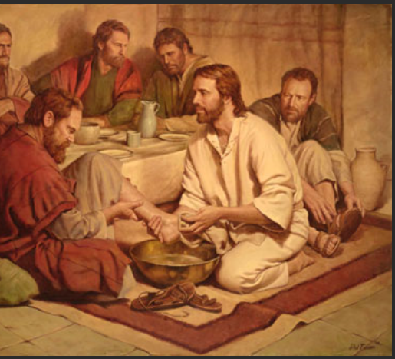
Christ Our Example
John 13
Washing the Disciples Feet
“You do not realize now what I am doing, but later you will understand.” - John 13:7 NIV

Slide 18
God Only Knows
We can start over! We can start over!

Slide 19
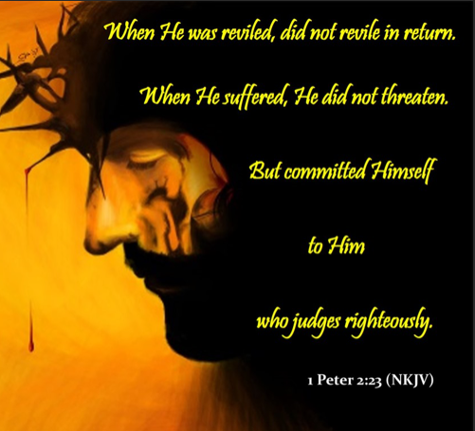
Committed Himself to Him who Judges Righteously
I Peter 2:21-25
  Did not sin neither was guile found in his mouth – Isaiah 53:9
  Did not retaliate when suffering wrong – Meekness
  Opened not his mouth – Isaiah 53:7
Matthew 26:63
  But Jesus held his peace – keeping his testimony in tact! (DK)
  Christ never took offense or defended himself when before Pilate he witnessed a good confession
I Peter 4:16 & 19
  He took the hit for us!
  We are to take the hit for others!

Slide 20
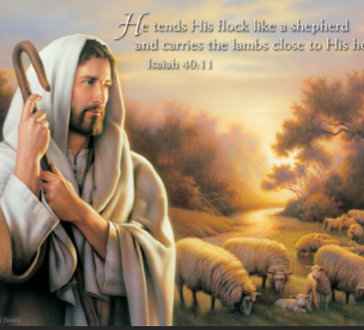
The Great Shepherd of Our Souls
Behold, the Lord GOD will come with strong hand, and his arm shall rule for him: behold, his reward is with him, and his work before him.
He shall feed his flock like a shepherd: he shall gather the lambs with his arm, and carry them in his bosom, and shall gently lead those that are with young.
    Isaiah 40:10-11

Slide 21
God Only Knows

Slide 22
