Slide 1
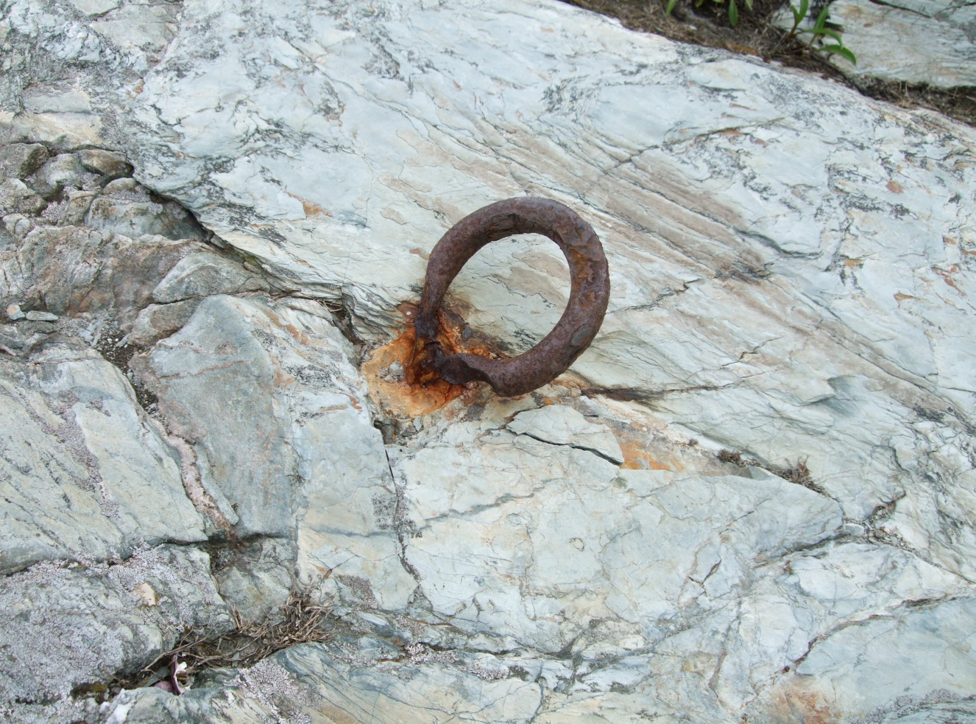
Bristol Bible Chapel
October 6, 2013

Slide 2
Scripture
‘Potpourri’
Acts 2:42, Fellowship & Prayers
A Look at the Entire Bible
2 Corinthians 8-9, NT Giving

Slide 3
Acts 2:42
And they continued steadfastly in the apostles' doctrine and fellowship, and in breaking of bread, and in prayers.

Slide 4
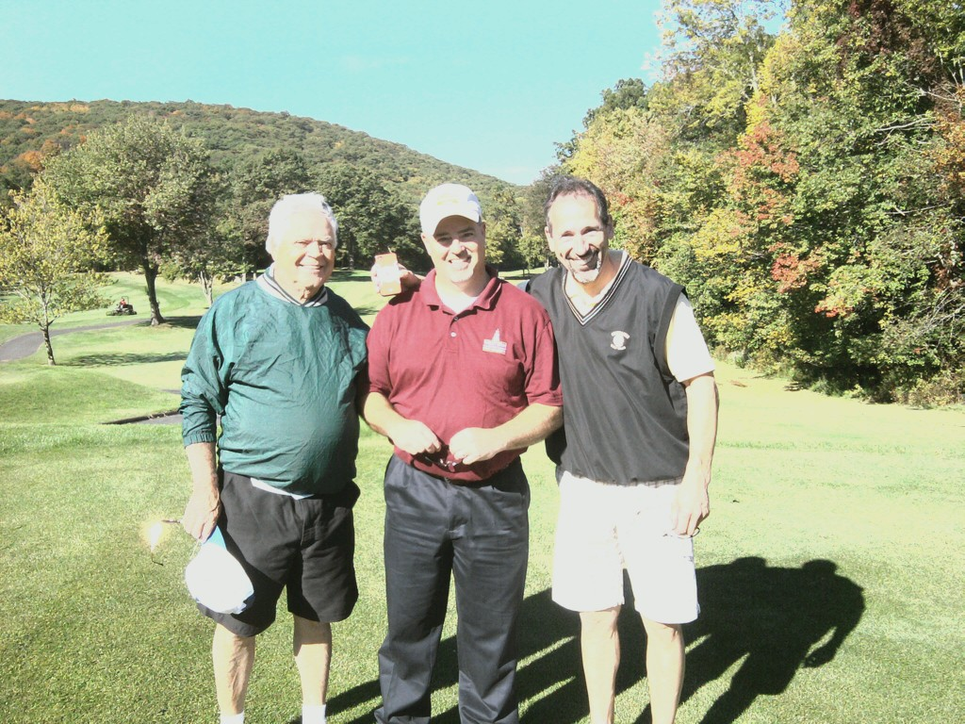
Fellowship
Danbury, CT
A Great Day!

Slide 5
Prayers
Col. 1:9 For this cause we also, since the day we heard it, do not cease to pray for you, and to desire that ye might be filled with the knowledge of his will in all wisdom and spiritual understanding;
Heb. 4:16 Let us therefore come boldly unto the throne of grace, that we may obtain mercy, and find grace to help in time of need.

Slide 6
Scripture Guide

Slide 7
Scripture Guide
Some Work Done for You
Genesis--1445-1405 B.C. | Moses; The Beginnings; God selects a people for Himself; Abraham->Isaac->Jacob (Israel)
Exodus --1445-1405 B.C. | Moses; Deliverance; God supernaturally protects and provides for His people
Leviticus --1445-1405 B.C | Moses; Holiness; God provides His people instructions for worship
Numbers--1445-1405 B.C. | Moses; Wilderness Wanderings; Two generations of Israel by the numbers (40 years)
Deuteronomy--1445-1405 B.C. | Moses; Final Instructions; God provides instructions to Israel before possessing the land

Slide 8
Scripture Guide
Some Work Done for You
Genesis--1445-1405 B.C. | Moses; The Beginnings; God selects a people for Himself; Abraham->Isaac->Jacob (Israel)
Exodus --1445-1405 B.C. | Moses; Deliverance; God supernaturally protects and provides for His people
Leviticus --1445-1405 B.C | Moses; Holiness; God provides His people instructions for worship
Numbers--1445-1405 B.C. | Moses; Wilderness Wanderings; Two generations of Israel by the numbers (40 years)
Deuteronomy--1445-1405 B.C. | Moses; Final Instructions; God provides instructions to Israel before possessing the land
Other Information
  Meaning of Author’s Name
  Important Verses
  Chapter Outlines
  Word Studies

Slide 9
Scripture Guide
Some Work Done for You
Genesis--1445-1405 B.C. | Moses; The Beginnings; God selects a people for Himself; Abraham->Isaac->Jacob (Israel)
Exodus --1445-1405 B.C. | Moses; Deliverance; God supernaturally protects and provides for His people
Leviticus --1445-1405 B.C | Moses; Holiness; God provides His people instructions for worship
Numbers--1445-1405 B.C. | Moses; Wilderness Wanderings; Two generations of Israel by the numbers (40 years)
Deuteronomy--1445-1405 B.C. | Moses; Final Instructions; God provides instructions to Israel before possessing the land
Other Information
  Meaning of Author’s Name
  Important Verses
  Chapter Outlines
  Word Studies
Isaiah--740-680 B.C. | Isaiah; Israel’s Messiah; Comprehensive book on Messiah’s redemptive work & grace

Slide 10
NT Church Giving

Slide 11
NT Church Giving
It is NOT Tithing…
  Le 27:30 And all the tithe of the land, whether of the seed of the land, or of the fruit of the tree, is the LORD'S: it is holy unto the LORD.
  Le 27:32 And concerning the tithe of the herd, or of the flock, even of whatsoever passeth under the rod, the tenth shall be holy unto the LORD.
Exodus 25 and 35

Slide 12
NT Church Giving
It is a matter of the Heart!
  Personal
  Free-Will
According to what you have
  Not what you do not have!

Slide 13
NT Church Giving
2 Corinthians Chapters 8 an 9
  8:1-9 A Pattern for Giving
    Macedonians (1-7)
    Jesus (8-9)
  8:10-15 A Purpose for Giving
  8:16-9:5 A Procedure for Giving
  9:6-15 A Promise for Giving

Slide 14
NT Church Giving
8:1-7 A Pattern for Giving
  Always starts with the Grace of God
  Super-abounding liberality
  Willing of themselves – Voluntary
  Praying how to best serve and determining the will of God
Philippians 4:14-19

Slide 15
NT Church Giving
Paul was communicating to the Corinthians the wonderful act of Christian generosity from the Macedonian Churches. That even though they themselves were impoverished, their desire to give toward the needs of others (the saints in Jerusalem) outweighed their own needs. Their pattern for giving is a model for every individual (and church) for every generation…they first committed themselves to the Lord (by implication, prayer) before deciding what they would give. And now that Titus is there with you, perhaps you Corinthians will consider your part in this matter (just as the Macedonians did)…a very nice way of presenting the need to Christian believers for their own personal consideration (without emotional pressure).

Slide 16
NT Church Giving
8:9 Jesus the Perfect Pattern
  “For ye know the grace of our Lord Jesus Christ, that, though he was rich, yet for your sakes he became poor, that ye through his poverty might be rich. “
  Paul’s communication about giving was not a command! But rather he was merely reminding them that this was an opportunity for them to demonstrate in a tangible way their Christian love…modeling the perfect pattern of the Lord Jesus. Although He was very rich, He considered Himself to be poor (indigent; a beggar); so that through His poverty (through the giving of His wealth to us); we might become rich…a life for a life! Jesus is the ultimate sacrifice.

Slide 17
NT Church Giving
8:10-15 A Purpose for Giving
  V.14 “But by an equality, that now at this time your abundance may be a supply for their want, that their abundance also may be a supply for your want: that there may be equality:”
  Paul now addresses the purpose for giving. He is reminding them that a year ago they had a willingness to give. Now is the time to make that previous willingness a reality. But he reminds them of a very important principle (v.12); that there must be a continued willingness and only as the Lord has made you able (not from what you do not have). This is so that there is equality…no one is burdened with the magnitude of having to provide for a need and that once given everyone was provided for (just enough).

Slide 18
NT Church Giving
8:16-9:5 A Procedure for Giving
  Gifts are entrusted to faithful men
    Titus and the other ‘brother’
  Always a plurality (safety)
  It is OK to keep reminding the Saints (and only Saints) of the needs

Slide 19
NT Church Giving
9:6-15 A Promise for Giving
  Sowing and Reaping (sparingly vs. bountifully)
  Give as your heart directs (not grudgingly or under compulsion)
  God loves a cheerful (hilarious) giver
  Increased thankfulness (v.12)
  God and the Gospel are glorified (v.13-14)
No one can out-give God!

Slide 20
NT Church Giving
It is a matter of the Heart!
  Personal
  Free-Will
According to what you have
  Not what you do not have!

